Slide 1

STANLEY COLLEGE OF ENGINEERING AND TECHNOLGY FOR WOMEN (AUTONOMOUS)
Abids. Hyderabad – 500 001
(Affiliated to Osmania University & Approved by AICTE)
(All eligible UGC courses are accredited by NBA & NAAC with ‘A’ Grade)
Department of Computer Science and Engineering
Academic Year: 2025-2026
Internship Presentation
On
Strategic Innovation and Business transformation : Bridging technology ,leadership and Global Impact
Mr. M . Sai Ramakrishna
Assistant Professor
Department of CSE
PRESENTED BY
Sri Akshainie
160622733064

Slide 2
INTERNSHIP - II DETAILS
Course Code: SPW611 CS Credits: 1 Evaluation: CIE - 50 Marks
Title: Strategic Innovation and Business transformation : Bridging technology ,leadership and Global Impact
Name of the Student: Sri Akshainie
Roll Number: 160622733064
Batch / Section: 2024 – 2025 / B
Name of the Organization: Botho University
Duration of Internship: From 07th April 2025 to 07th August 2025
Mode (Onsite / Online / Hybrid) : Online
Industry Supervisor: Prof. Srinath Doss
Faculty Coordinator / Supervisor: Mr. M. Sai Ramakrishna

Slide 3
Contents
Abstract
Problem Statement
Background and Literature Review
Planning and Design of Work
Research Frame work
Implementation and Execution
Proposed conceptual model
Testing / Validation
Results and Analysis
Challenges and Solutions
Conclusion and Future Scope
References

Slide 4
Abstract
This project explores how businesses use modern technologies and strong leadership to drive innovation and digital transformation. It shows how tools like AI and IoT improve efficiency, support decision-making, and create new opportunities. The study also highlights the importance of ethical and sustainable practices in achieving long-term global impact, supported by real industry examples

Slide 5
1. Problem Statement
Businesses are experiencing rapid technological change but struggle to adopt innovation effectively. Many lack proper digital strategies, leadership alignment, and readiness for transformation. This results in slow adaptation, reduced competitiveness, and limited global impact..

Slide 6
2. Background and Literature Review
Digital transformation is accelerating due to advancements in AI, IoT, cloud computing, and automation.
Literature shows AI-driven analytics improves decision-making, forecasting, and operational efficiency.
IoT enables real-time data collection and smart process optimization across industries.
Cloud technologies support scalable, secure, and flexible business operations.
Studies highlight that combining technology with strategic leadership results in successful business transformation.
Research also stresses the importance of integrating ethical AI, cybersecurity, and data governance to ensure sustainable innovation

Slide 7
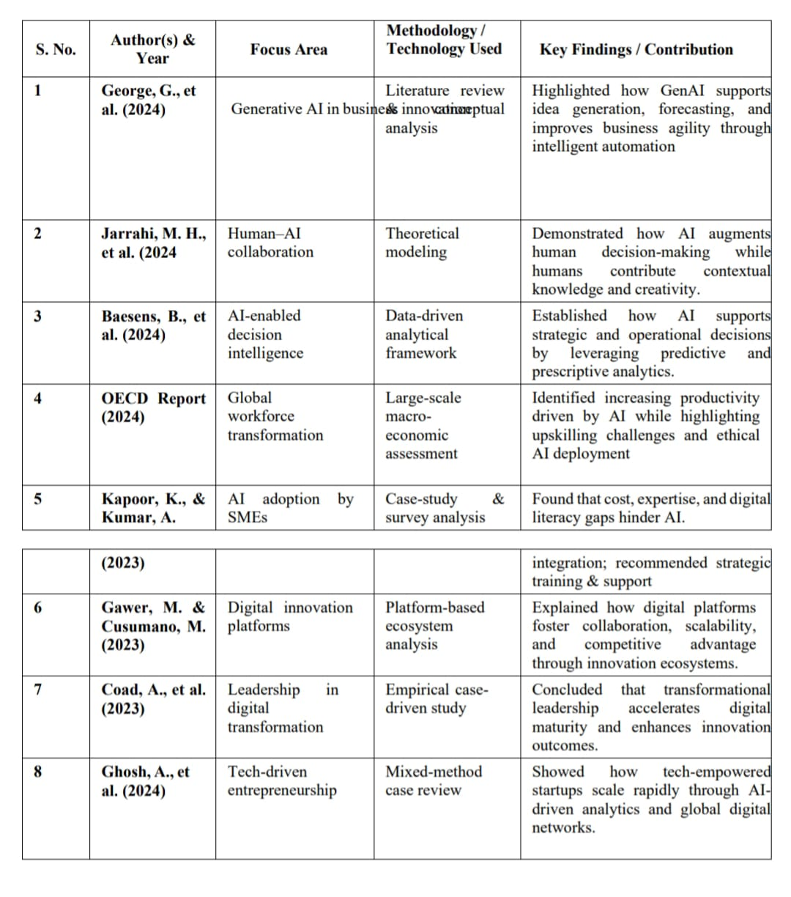
Table 2.1: Summary of reviewed literature

Slide 8
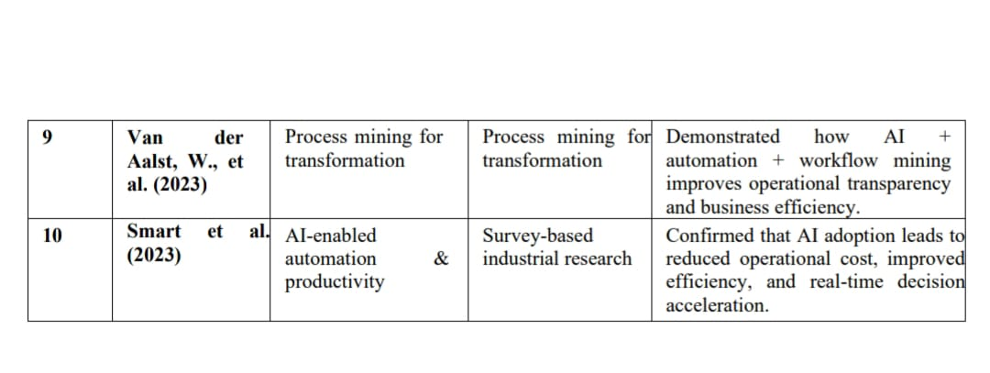
Table 2.1: Summary of reviewed literature

Slide 9
3. Planning and Design of Work
Identified key topics related to strategic innovation and digital transformation.
Collected relevant research papers, technical articles, and industry case studies.
Designed a structured framework to study AI, IoT, and other emerging technologies.
Analyzed leadership models and their role in technology-driven transformation.
Organized the findings into clear sections for the book chapter and presentation.

Slide 10
4 Research framework
-> Focuses on studying strategic innovation and digital transformation models.
-> Examines the role of AI, IoT, and other emerging technologies in shaping businesses.
-> Analyzes leadership approaches that support technology-driven change.
-> Integrates sustainability and ethical practices into the transformation process.
-> Connects technological, organizational, and global impact factors into a unified framework.

Slide 11
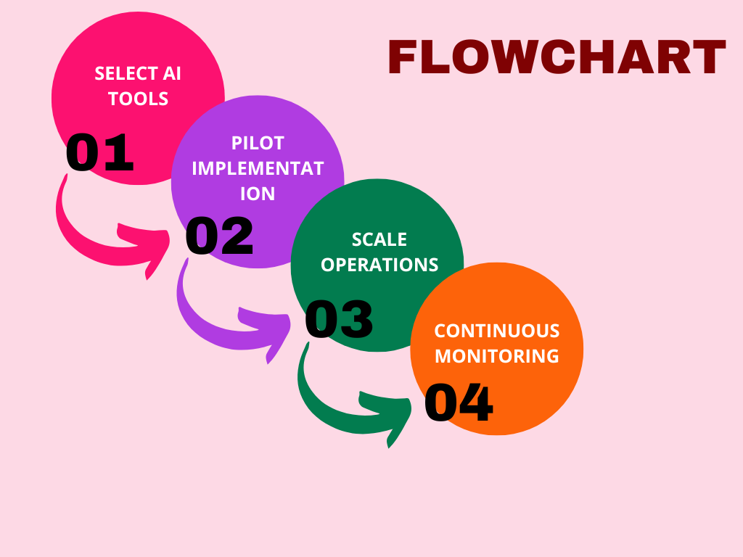

Slide 12
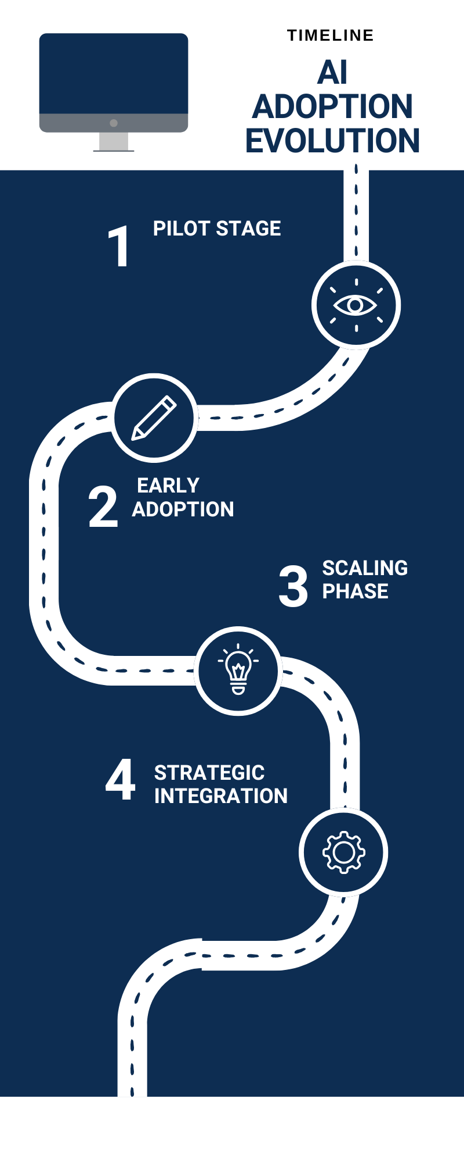
5. Implementation and Execution
Collected and reviewed research papers, industry reports, and global case studies.
Analyzed how AI, IoT, and digital technologies are applied in real business environments.
Compared different leadership models and transformation strategies across organizations.
Organized insights into tables, diagrams, and frameworks for clarity and evaluation.
Integrated all findings to develop a cohesive understanding of strategic innovation and business transformation.

Slide 13
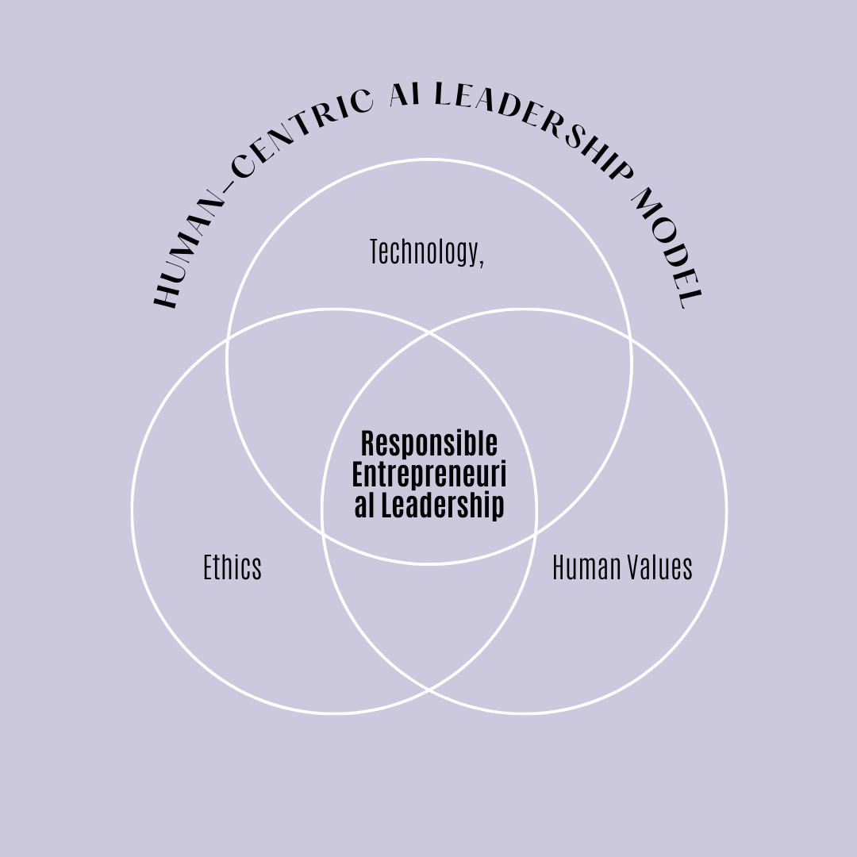
6. Proposed conceptual model
Technology Integration: Emerging tools like AI, IoT, and cloud computing act as the core drivers enabling innovation and operational efficiency.
Leadership Alignment: Transformational and digital leadership guide technology adoption, change management, and strategic decision-making.
Innovation Framework: Combining technology with organizational creativity encourages continuous improvement and new business models.
Sustainability & Ethics: Ethical AI, data governance, and sustainable practices ensure long-term responsible growth.
Global Impact: When these elements work together, businesses achieve scalable transformation, enhanced competitiveness, and broader global influence

Slide 14
7. Testing / Validation
Validated findings by comparing insights across multiple research papers and studies.
Cross-checked technological concepts like AI and IoT with industry case evidence.
Ensured consistency of the proposed framework with existing transformation models.
Verified relevance through real-world examples from different sectors.
Reviewed conclusions with standard research guidelines to ensure accuracy and reliability.

Slide 15
8. Results and Analysis
The study shows that AI, IoT, and cloud technologies significantly improve business efficiency and decision-making.
Analysis of literature reveals that organizations with strong digital leadership achieve smoother and faster transformation.
Case studies confirm that technology + leadership alignment leads to higher innovation performance.
Ethical and sustainable practices were found to enhance trust, long-term stability, and global relevance.
Overall results indicate that companies adopting strategic innovation frameworks gain better competitiveness and global impact.

Slide 16
9. Challenges and Solutions
Challenges: Difficulty in adopting emerging technologies like AI and IoT.
Lack of skilled workforce for digital transformation.
Limited leadership readiness for tech-driven change.Concerns related to data privacy, security, and ethics.
High cost of implementing advanced digital systems.
Solutions: Provide continuous digital training and skill development.Implement technology adoption in phased, strategic steps.
Promote transformational and innovation-focused leadership.
Strengthen data governance and ethical AI practices.
Use scalable, cost-effective cloud and automation tools..

Slide 17
10. Conclusion and Future Scope
Conclusion:
Strategic innovation supported by AI, IoT, and digital tools is reshaping modern businesses.
Leadership plays a critical role in guiding technology adoption and driving transformation.
Ethical, sustainable, and data-driven practices strengthen long-term global impact.
Future Scope:
Increased use of AI automation and smart technologies across industries.
Higher focus on ethical AI, cybersecurity, and responsible innovation.
Growth of digital leadership models and global tech collaborations.

Slide 18
References
-> M. I. Haque, S. Saha, and A. Rahman, “Blockchain for Secure Medical Data Sharing Using Hyperledger Fabric,” IEEE Access, vol. 12, pp. 13842–13856, 2024.
-> AWS. (2023). Human-in-the-loop and human-centric AI integration for startups. AWS Whitepaper.
-> Brynjolfsson, E., & McAfee, A. (2017). Machine, platform, crowd: Harnessing our digital future. W.W. Norton & Company.
-> Brynjolfsson, E., & McAfee, A. (2021). The future of work in the AI age. MIT Press.
-> Bughin, J., Seong, J., Manyika, J., Chui, M., & Joshi, R. (2018). Skill shift: Automation and the
future of the workforce. McKinsey Global Institute.

Slide 19
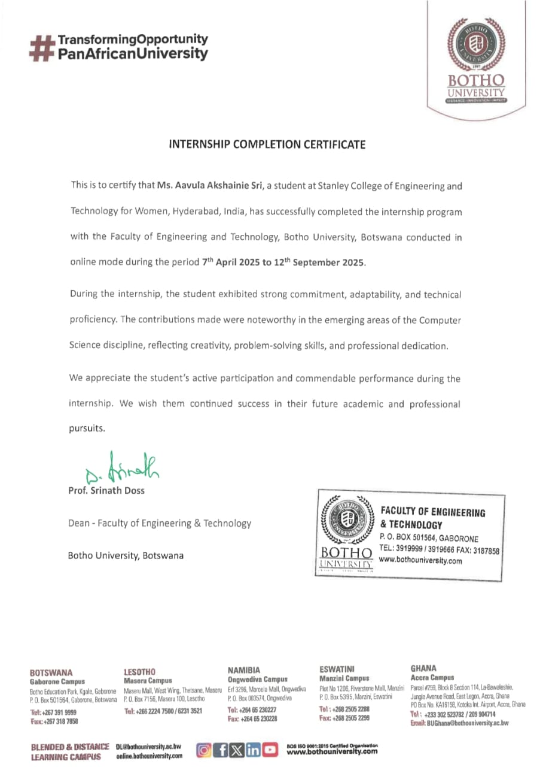
Internship Completion Certificate

